Slide 1
UGATE
Smart Security System
Presented by:
Vaishnavi Kompally & Alla Leela Srija

Slide 2
Contents:
Introduction
Aim & Impact
Budget & Development Process
Competitive Analysis
Gap Analysis
Stakeholders
Requirement Analysis
Functional Requirements
Non-Functional Requirements
6. Detailed Subsystems
7. Mock User Interface
8. Test Plan
9. Change Management
10. Risk Management
11. Conclusions

Slide 3
Introduction:
Aim of the project:
Design a system to support a digitized security management for University including both verification software and human security officers. System is aimed to address everyone who enters the campus through the main gate.
Impact:
University of Hyderabad has around 5000 students with a faculty of 400 and a huge staff working for maintenance of the campus. The campus also offers maximum freedom to students, as there is no time restriction in terms of entry and exit.

Slide 4
The system we develop
Ensures safety and prevents unauthorised entries into the campus.
Eliminates the need to manually reach out insiders for outsider approvals.
Allows security officers to collect the packages dropped at the gate by delivery executives as per their customer instructions.
Budget:
Module Name | Quantity | Cost Estimate
Device to scan QR code | 1 | 7000 INR
Automatic Boom Barriers | 1 | 38,000 INR
Device to manage verifications. | 1 | 5000 INR
 | Total Cost | 50,000 INR

Slide 5
Development Process:
This system requires automation and integration of different software subsystems and continuous upgrades and releases.
The development team is well aware of both user and system requirements. On the other hand, the operations team is sensitive about managing resources, quality, frequency and stability of releases.
Focusing on the need for collaboration between development and operations teams at all stages of the software development life cycle, DevOps is adopted.

Slide 6
Competitive Analysis:
Features/ Competitors | Our product | MyGate | NoBrokerHood Visitor Gate & Security Management | JioGate
Strengths | Can manage large numbers efficiently Suitable for universities and colleges Automatic insider verification | Suitable for small residential communities Community management | Suitable for small residential communities Community management | Suitable for small residential communities Community management

Slide 7
Weaknesses | Visitor and delivery executive tracking is not implemented | Unsuitable for universities and institutions with large population | Unsuitable for universities and institutions with large population | Unsuitable for universities and institutions with large population
Target Customers | Universities, colleges and large companies | Gated communities and apartments | Gated communities and apartments | Gated communities and apartments
Onboarding experience | Easy user interface | Smooth instructions | Easy user interface | Enables anyone to create a society and use it with simple UI

Slide 8
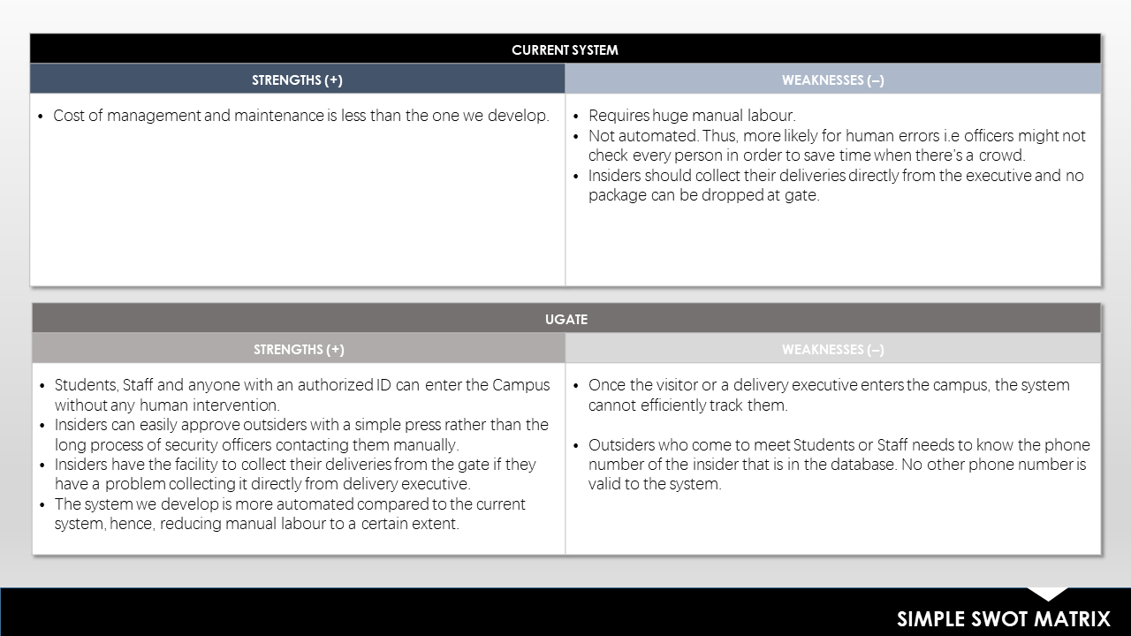
Gap Analysis

Slide 9
Stakeholders
Students
Faculty
Daily staff working for the university
Administration
Visitors
Delivery Executives
Transportation services within university
Cabs

Slide 10
Roles:
Dev Includes all people involved in developing software products and services including but not exclusive to:
Architects, product owners, project managers, quality assurance (QA), testers and analysts, suppliers.
Ops Includes all people involved in delivering and managing software products and services including but not exclusive to:
Information security professionals, systems engineers, system administrators, IT operations engineers, release engineers, database administrators (DBAs), network engineers, support professionals and suppliers.

Slide 11
Requirement Analysis
Functional Requirements
User Requirements:
Every person with an authorised ID shall be able to enter the campus.
An insider i.e. students,faculty or staff shall be able to easily approve their visitors with digitized communication with gate.
A visitor, delivery executive or a cab driver shall be able to enter the campus after verification of insider by system and approval from the insider.
A delivery executive can leave the packages/deliveries at the gate if instructed by their customer belonging to the university.

Slide 12
5. One should be able to collect packages from the security, within the given time. In case of food deliveries, packages are expected to be collected within 1 hour from the time of drop. Other deliveries are supposed to be collected within 6 pm of that particular day.
6. People entering the university for admissions, examinations and other special events should be directed to the security officer.
System Requirements:
The system shall be able to verify the authorized people by scanning their ID.
The system shall be able to prevent unauthorized entries to the campus.
The system shall be able to verify visitors with an approval from insiders.
The security officer should keep the delivery executive’s ID and send him in.
The security should be able to collect packages from delivery executives and secure them until they are picked within the given time.

Slide 13
Non-Functional Requirements
Organizational requirement:
Users are not allowed to add any other user or change certain information.
Performance requirement:
The system shall work for 24 hours on all days unless the administration orders otherwise.
Security Requirement:
Information of the insider should not be disclosed to anybody.
Information of visitors and delivery executives is not stored.
Capacity requirement:
System should be capable enough to handle multiple users at the same time.

Slide 14
Dependability requirement:
Software Failure: If the insider does not receive any notification for approval of an outsider, security manually manages the issue with a phone call in most cases.
Hardware failure: If the gate fails to open after insider verification security would open it manually.
Operational failure: If a person fails to collect their package from the gate in the given time their packages are sent to storage and no security guard at the main gate is responsible. Only the managers of the storage are responsible for 5 days.
Usability requirement:
The user interface should be simple, consistent and easy to use for students, Faculty and outsiders as well.
To reduce the time taken for verification and make it more automated, outsiders are asked for minimal information which in this case is a phone number.

Slide 15
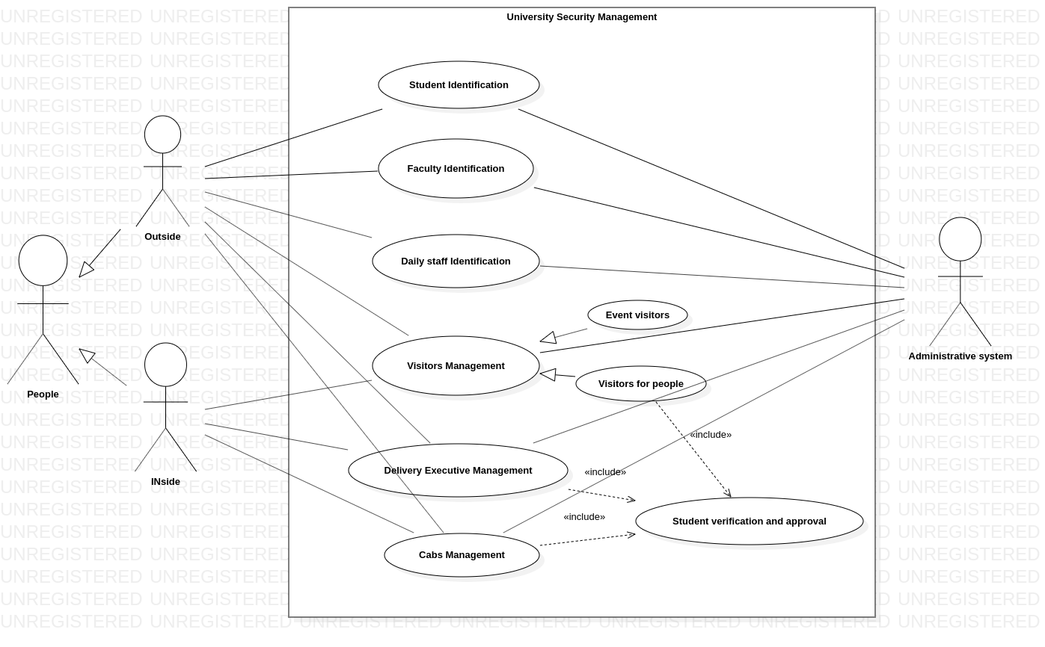
Use case Diagram

Slide 16
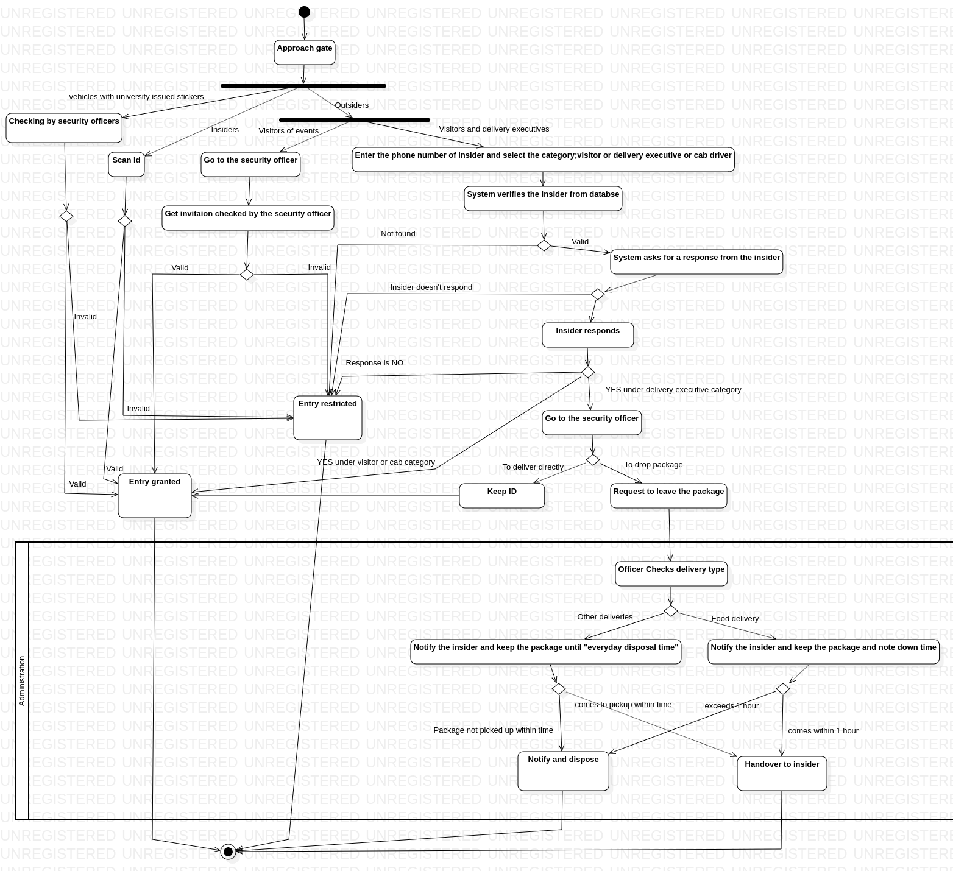
Activity Diagram

Slide 17
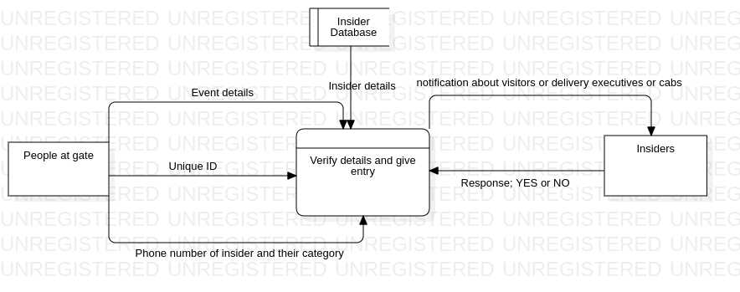
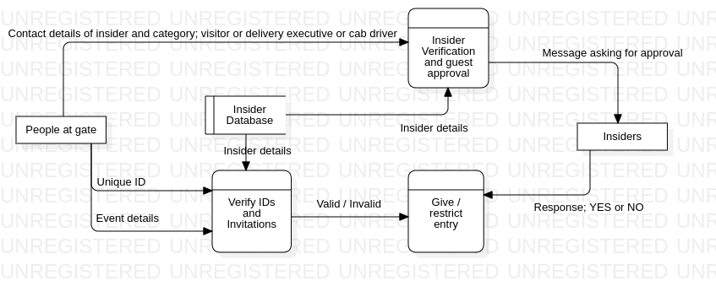
Data Flow Diagram
Level 0 DFD
Level 1 DFD

Slide 18
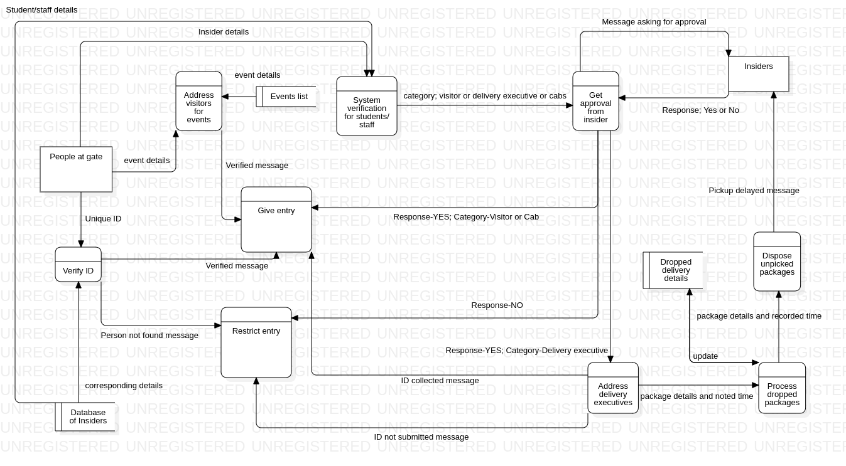
Level 2 DFD

Slide 19
Alternative Architecture:
Agile Methodology can be an alternative approach to this project.
It emphasizes on iterative, incremental and evolutionary development.
It breaks down the process into smaller units and integrates them for final testing.
It provides the ability to rapidly adapt to the changing requirements and reduces technical risk of the project.
The end result of the architecture emerges in increments faster at first because of the need to set a foundation to the project.
Part of the effort in agile architecture is for initial requirement envisioning and architecture envisioning so that critical questions about the scope, cost, schedule and technical strategy of the project can be answered.
JIRA is a tool that supports any agile methodology such as scrum, kanban etc.
It is mainly an issue tracking tool that assists agile teams to plan and manage their projects.

Slide 20
Detailed Subsystems:
Subsystem is a group of interconnected and interactive parts that performs an important job or task as a component of a larger system.
Subsystems in this architecture:
Scanning and Verification of authorized IDs.
Verification of Authorized Vehicles with university issued stickers.
Verification of insider information entered by an outsider.
Insider approving their visitors, delivery executives and cabs.
Security officers collect delivery executives’ ID and give back on their return.
Management of deliveries dropped at the gate.
Management of visitors for events, examinations and others.

Slide 21
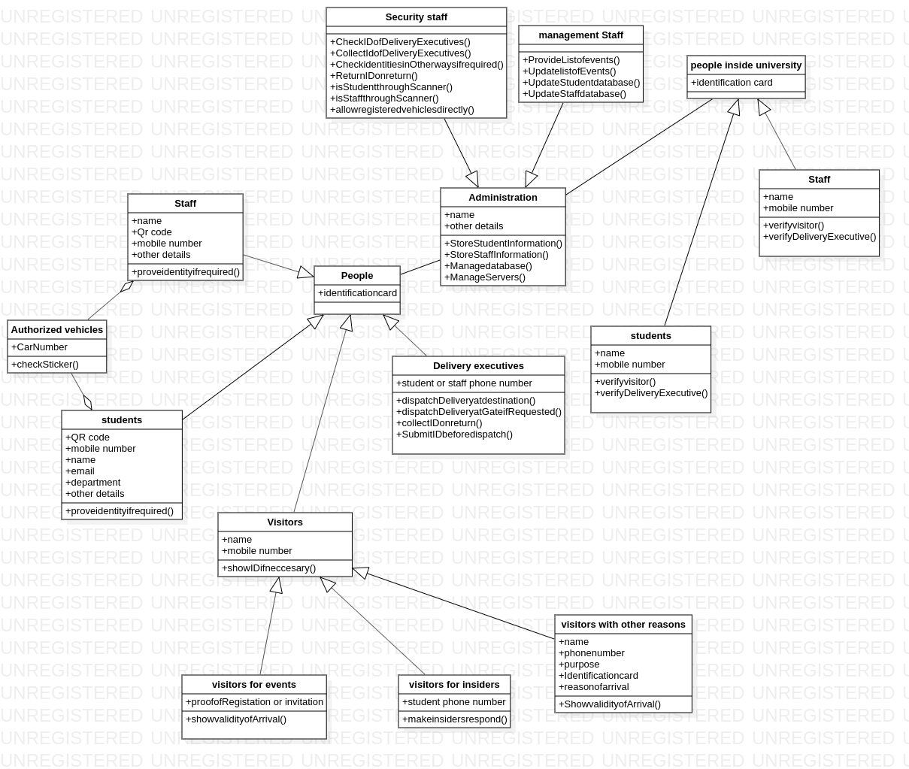
Class Diagram

Slide 22
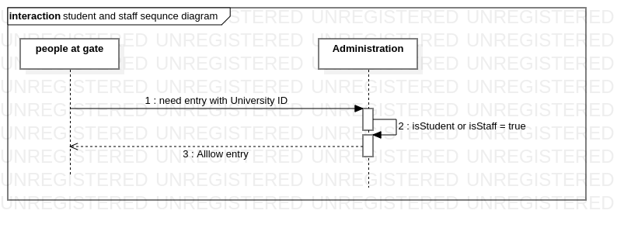
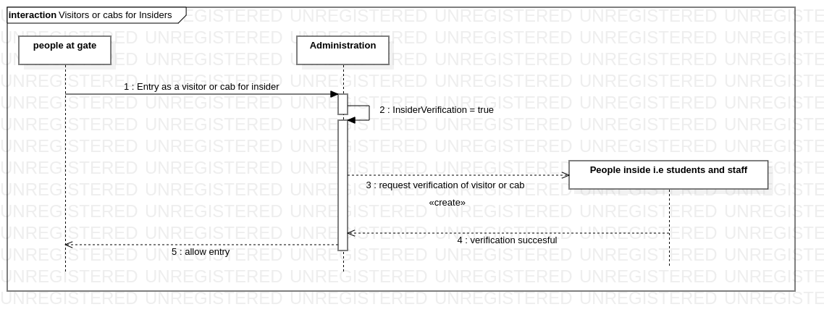
Sequence Diagrams

Slide 23
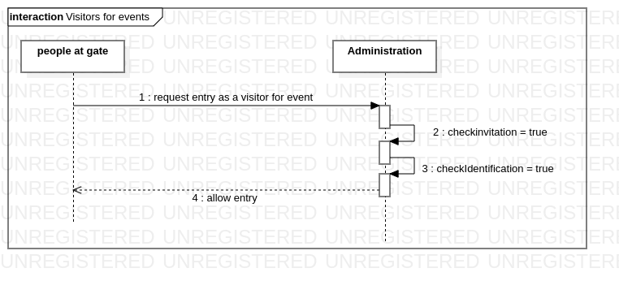
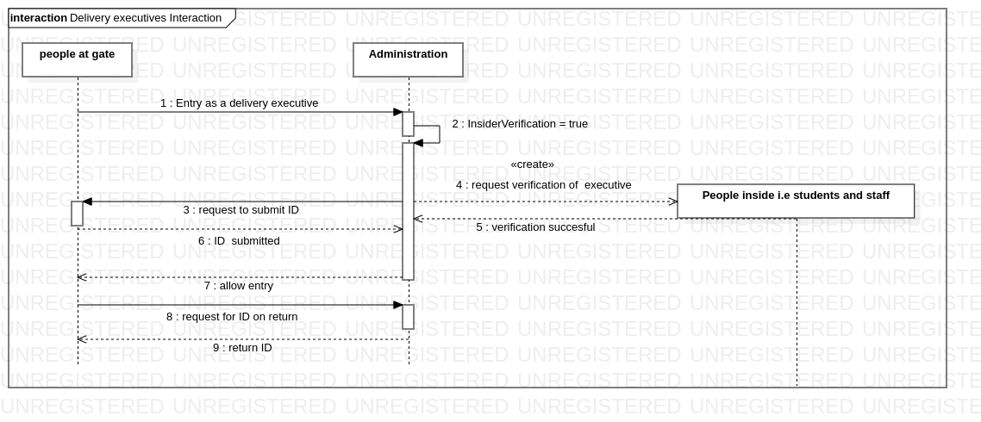

Slide 24
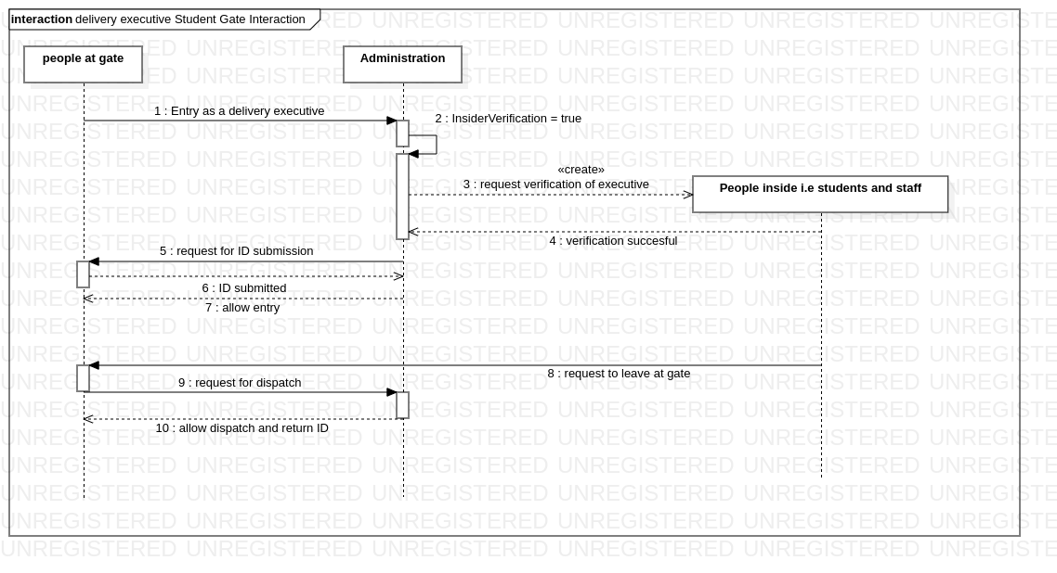
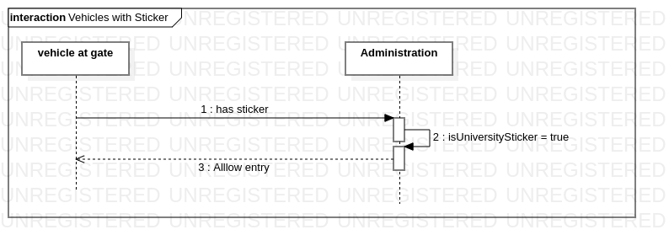

Slide 25
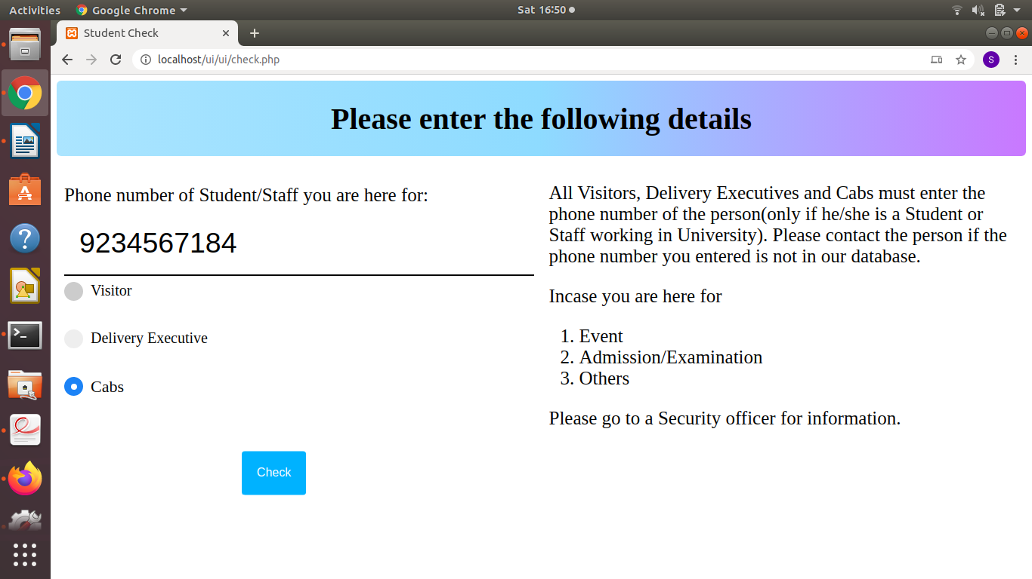
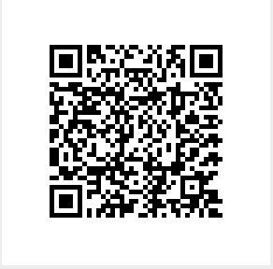
Mock User Interface:
Scan this QR code to see the Mock application.

Slide 26
Test Plan:
Objectives:
Identify the software that should be tested.
Identify the required resources.
Test the interfaces between different subsystems.
Test the performance measures of different functions.
Describe the testing strategies and tools.
Features to be tested:
Authorized ID verification by scanning.
Automatic verification of insiders.
Insiders approving visitors, delivery executives and cabs through application.
Security officers collecting IDs of executives.
Security officers collecting packages at the gate.
Proper disposal of uncollected packages within the proposed time.

Slide 27


Testing types:
Unit Testing
Defect Testing
Usability Testing
Back-end Testing
Regression Testing
Recovery Testing
Tools and Automation:
Framework: Azure Devops Framework
Code and Build: Git integrated with Azure Pipeline
Testing and Deployment: Azure Pipeline

Slide 28
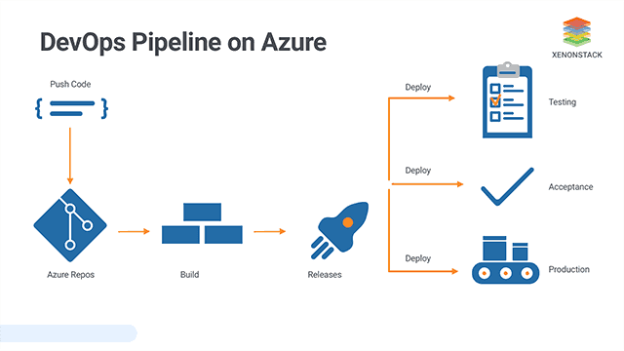
Continuous Testing:
The goal of Continuous Testing is to test early and test often. The process involves stakeholders like Developer, DevOps, QA and Operational system.
Pair testing:
The testing of the software system is done by two team members at a single workstation. One does the testing and the other reviews and analyzes the test results. It breaks down the communication barrier.

Slide 29
Change Management:
DevOps Approach for Change Management:
Change management becomes easier and faster when the team is DevOps-minded.
Change management frameworks are generally designed to deal with large-scale changes, identifying dependencies and operational risks.
DevOps follows a reverse approach by optimizing for small frequent changes, breaking big changes into smaller iterative steps and trying to automate how they are managed.
Through improved collaboration, transparency and automation, changes can be faster and more reliable.
The model combines continuous integration, continuous testing and continuous delivery allowing the team to react in a timely manner.

Slide 30
Generally process involves the following steps:
Check for change requests
Perform impact analysis
Change risk assessment
Change implementation
During the implementation of transitions:
Once a milestone is achieved, do a retrospective to assess the current state. If it’s in-line with the expected results, initiate the next step.
After the transition, perform testing and identify the issues that have come up as a result of the new process.
Urgent changes may have to be implemented without going through all stages of the software engineering process.

Slide 31
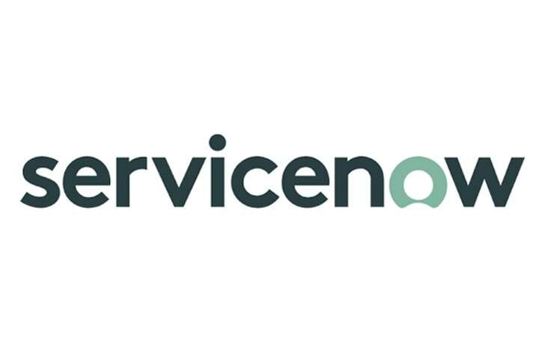
Change Management Tool:
Integrated with Azure DevOps:
Specific change management sub processes in this tool include:
Change risk assessment
Change scheduling
Change approvals and oversight.
This change management extension for Azure DevOps helps
Automate the process involving
Reduce chances of human errors
Increase deployment agility.

Slide 32
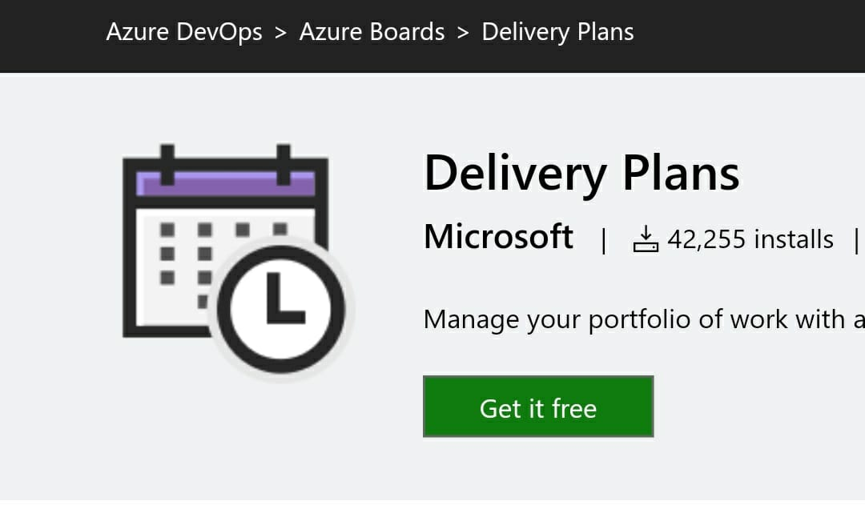
Project Plan:
As we follow DevOps approach, all the subsystems go through several iterations of development and testing.
Azure Pipeline tests them continuously and delivers them to our choice of end point.
Tool for Planning:
Delivery Plans is an extension of Azure DevOps and is easy to use

Slide 33
Risks:
Human errors:
Students can enter the campus by approving themselves as visitors when they forget their IDs.
Delivery executives can enter as visitors if approved by their customers.
Wrong entries by visitors or delivery executives or cab drivers.
Hardware Failures:
In cases where the scanner fails to recognize a valid code.
Gate mechanism failure.
Software failure:
When there are server problems and the student can’t receive notification but the security is unaware of the issue.
Risk-mitigation:
To prevent scanner and gate issues, they should be checked and monitored frequently.
Employers should constantly check the status of servers on both sides.

Slide 34
Conclusions:
Possible Extensions:
This security system can be implemented at all gates in the University and integrate all gates.
Monitor entries and exits of visitors, delivery executives and cabs.
Overstay alert for delivery executives.
Learnings & Challenges:
The whole security system cannot be automated. There are certain issues in security which only humans can solve.
Human errors cannot be totally exhausted.
Integrating the system with e-governance.
High budget and maintenance issues.
Executional challenge: COVID-19.

Slide 35
Thank You…

